Slide 1
My vision for dairy genomics
George Wiggans, CDCB Technical Advisor

Slide 2
Where are we now?
Over half a million animals genotyped in 2016
67% of AI breedings to genomic bulls
Genomic relationship between genotyped cows and marketed bulls available
Evaluations on new animals released weekly

Slide 3
Genotype counts by animal sex

Slide 4
AI breedings to genomic bulls

Slide 5
Release of evaluations
Download from CDCB FTP site with
separate files for each nominator
Weekly release of evaluations of new animals
Monthly release for females and bulls not marketed
All genomic evaluations updated 3 times each year with traditional evaluations

Slide 6
Where are we going?
Increasing number of cows genotyped
Falling cost per SNP genotyped
Increased accuracy of genomic evaluations from more informative SNPs
Genomic evaluations on more traits to predict economic merit more accurately
Increased use of genomics in mating programs

Slide 7
Genotype counts by chip density (2016)

Slide 8

Parentage validation and discovery
Parent-progeny conflicts detected
  Animal checked against all other genotypes
  Reported to breeds and requesters
  Correct sire usually detected
Maternal grandsire checked
  Less certain than parentage checking
Who’s your daddy?

Slide 9
No evaluation if grandsire unlikely
Planned implementation later this year
Imposed to reduce evaluation volatility
  Forces pedigree correction before evaluation release
Grandsire or parent can be set to unknown if correction not available
Breed associations
  Encourage genotyping parent
  Allow making grandsire unknown with adjustment to registry status

Slide 10
Generation interval – Holstein

Slide 11
Marketed Holstein bulls

Slide 12
Improving accuracy
Increase size of predictor population
  Share genotypes across country
  Young bulls receive progeny test
Use more or better SNPs
  Increase to 77K later this year
Account for effect of genomic selection on traditional evaluations

Slide 13
Imputation
Based on splitting genotype into individual chromosomes (maternal and paternal contributions)
Missing SNPs assigned by observing SNPs in ancestors and descendants
Imputed dams increase predictor population
Genotypes from all chips merged by imputing SNPs not present

Slide 14
Haplotypes affecting fertility
Rapid discovery of new recessive defects
  Large numbers of genotyped animals
  Affordable DNA sequencing
Determination of haplotype location
  Significant number of homozygous animals expected, but none observed
  Narrow suspect region with fine mapping
  Use sequence data to find causative mutation

Slide 15



Mating programs
Genomic relationships of genotyped females with available bulls provided
Determination of best mate possible
Dominance effects could be considered

Slide 16
Genomic evaluation of crossbreds
Breed base representation (BBR) gives percentages of 5 breeds
Calculate evaluation by weighting purebred SNP effects by BBR
Depends on doing genomic evaluations on the all-breed base and adjusting to individual-breed base last
Implementation likely in 2018

Slide 17
Working with sequence data
Sequence data available from 1000 Bull Genomes Project hosted in Australia
Project funded by industry to sequence nearly 200 bulls to create a haplotype library
Quality affected by replication (e.g., 10X), methods of detecting variants, and imputation

Slide 18
DNA
39.7 million variants detected in sequence data
481,904 variants in or near genes
1.49 million SNPs currently on chips
60,671 SNPs used in genomic evaluations

Slide 19
Use of sequence data
Discovery of causative genetic variants
Refinement of SNPs used in genomic evaluation
  Add discovered causative variants
  Use some SNPs for imputing but not for estimating SNP effects
Support imputation to enable immediate use of newly discovered causative genetic variants in genomic evaluation

Slide 20
Causative variants
Benefits of knowing causative variant
  Supports an exact test (particularly useful for undesirable conditions)
  No linkage decay when used in evaluation
  Increased reliability of genomic evaluations as causative variants replace less informative SNPs
  May be informative across breeds
Likelihood of discovery increased by greater availability of sequence data

Slide 21
Steps to add causative variant
Recommend that genotyping laboratories add variant in next chip update
Monitor genotype submissions to determine when sufficient genotypes with new SNPs have been submitted
  Benefit of new SNPs degraded if imputation error rate is high
Add to set of SNPs used in genomic evaluation

Slide 22
Project to find causative variants
Use sequence data from 1000 Bull Genomes Project
Impute Holstein reference bulls to sequence using 444 sequenced bulls
Use a posteriori granddaughter design on 75 bulls with ≥100 progeny-tested genotyped sons
  Identify heterozygous haplotypes for which son groups differ significantly
  Search for variants in concordance across all bulls
Alternatively, estimate effects of 481,904 SNPs and pick those with largest effects

Slide 23
Use of sequence data
Causative variant present in sequence data
Combine sequence data with medium- and high-density genotypes of reference bulls
Impute ~30,000 bulls to full sequence
Extract SNPs to be used in evaluation (including new causative variants)
Use these imputed genotypes in place of observed genotypes in monthly imputation for genomic evaluations

Slide 24
Benefits of 2-step imputation
Improved imputation accuracy because imputing to full sequence considers all SNPs in a haplotype
Computing time not excessive because only ~30,000 reference bulls processed
Accurate imputation of new SNPs for all animals supported because reference bulls are related to most animals in the evaluation

Slide 25
Changing SNP set in evaluation
Imputation most time consuming part of evaluation
  Previous month’s output used as priors
Change in SNP set prevents use of priors
Running without priors consumes excessive computing resources
Priors can be generated in reasonable time for 100,000 genotypes

Slide 26
Test of priors from 100K genotypes
Select ~100,000 Holstein genotypes
  Reference bulls
  Most cows with genotyped progeny
Impute without priors (1 day of computing)
Re-do imputation for December 2015 official evaluation using this run as priors
Evaluate accuracy by comparing with imputed genotypes from official evaluation

Slide 27
Results
Imputation for official December 2015 evaluation included genotypes of 978,987 Holstein bulls and cows
Nearly 60 billion comparisons
  Identical, 97.7%
  1 allele different, 1%
  1 missing, 1.2%
Method not perfect
  Uses current programs
  Direct augmentation of priors might be more accurate

Slide 28
Conclusions
New SNPs can be added as soon as discovered
  Saves time to place on chip
  Saves time to accumulate genotypes
Adding causative variants may permit removal of less informative SNPs
Elimination of low information SNPs may reduce “noise”
Adding markers that are causative variants should increase prediction accuracy

Slide 29
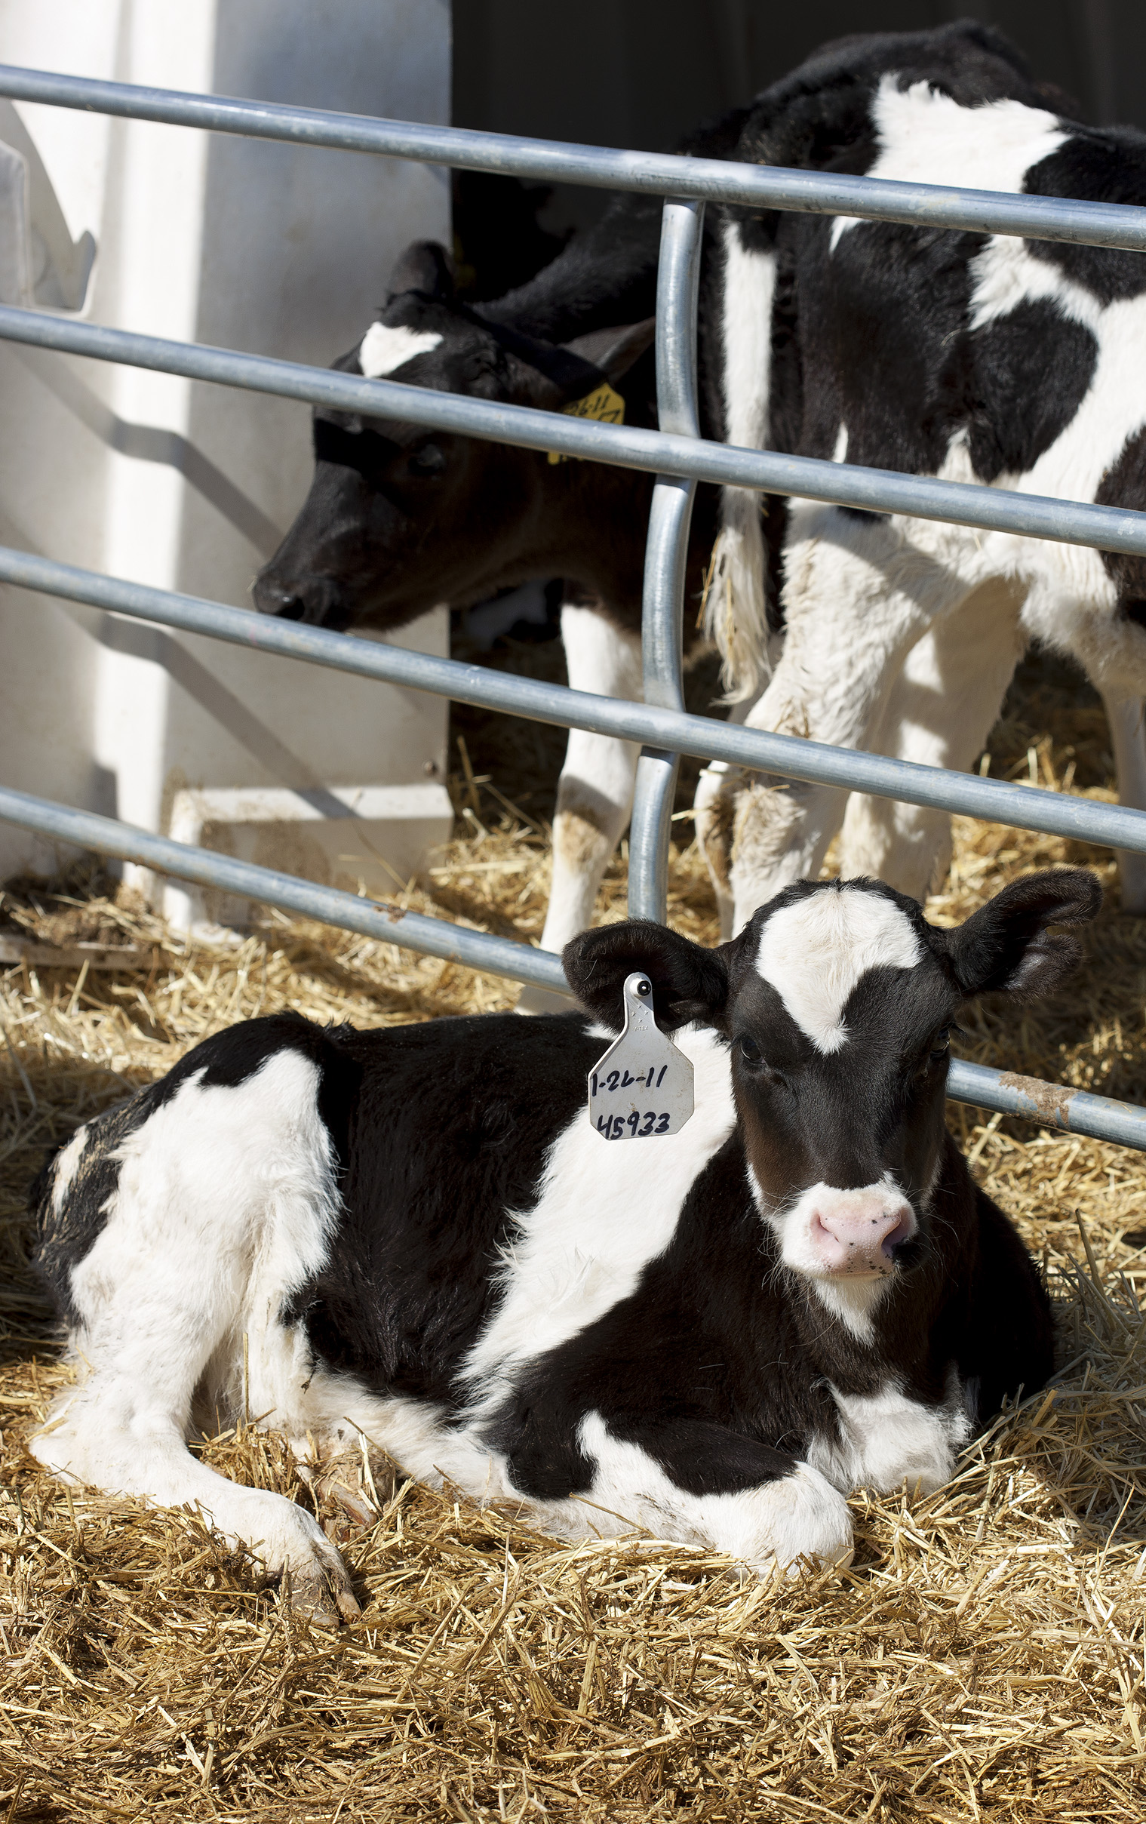
Evaluation of new traits
Mortality – Added August 2016
Gestation length – Planned for August
Health traits – Planned for December
Feed efficiency – Under development

Slide 30
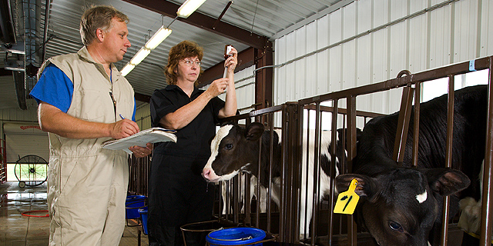
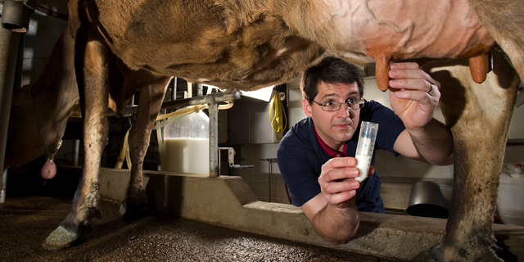
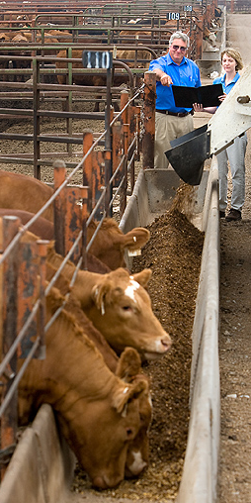
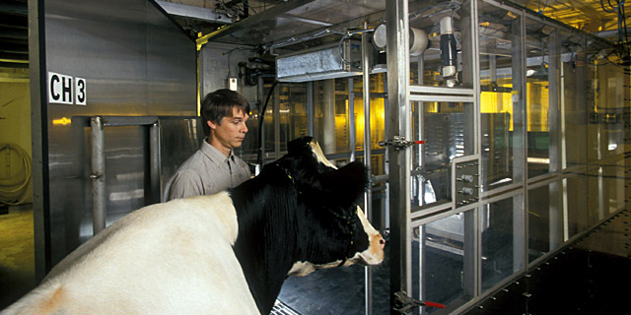
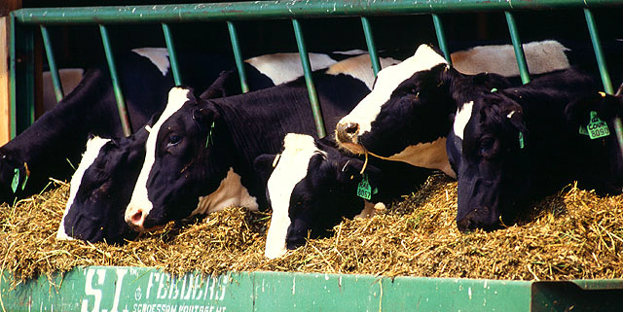
Traits requiring additional data
Clinical mastitis
Displaced abomasum
Ketosis
Hoof health
Immune response
Other health traits
Milking speed
Methane production
Mid‐infrared spectroscopy information for trait indicators

Slide 31
Upcoming health traits
Genomic evaluation of 6 common health events reported by producers
Traits selected based on:
  Economic importance
  Heritability
  Reporting consistency
Health events include:
  Hypocalcemia/Milk fever
  Displaced abomasum
  Ketosis
  Mastitis
  Metritis
  Retained placenta

Slide 32
Other possible new traits – data available
Days to first breeding
Persistency
Resistance to heat stress
(predicting genotype × environment interactions)

Slide 33
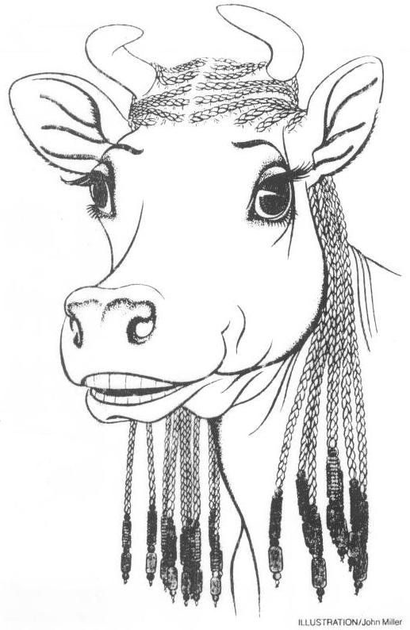
Impact on breeders
Haplotype and gene tests used in selection and mating programs
Trend towards a small number of elite breeders that are investing heavily in genomics
About 30% of young males genotyped directly by breeders since April 2013
In 2016, 67% of breedings to genomic bulls
Prices for top genomic heifers can be very high
(e.g., $265,000)

Slide 34
Summary
Highly successful program leading to annual increases in genetic merit for production efficiency
Large database of phenotypic and genomic data provided by industry
Research projects to determine mechanism of genetic control of economically important traits
Data processing techniques developed so that rapid turnaround can be realized

Slide 35

Questions?

